Slide 1
Binary file similarity detection model
Yangyang Zhang
Tongxi Xu
Munich, 06.05.2024
Automated Machine Learning for Multi-Label Classification

Slide 2

Binary file similarity detection model
Knowledge preperation
Binary file feature extraction
CFG extraction
Graph embedding
Similarity Comparison

Slide 3
01
Knowledge preperation

Slide 4
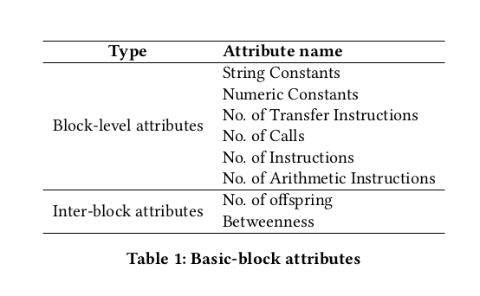
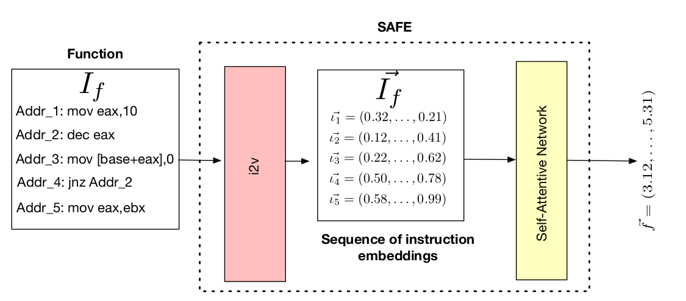
Binary file feature extraction
Based on artificially formulated features
Machine learning-based features
Notes:
In general, pre-trained language models are learned on a lot of text data in a self-supervised manner, and then fine-turned on downstream tasks
It is very popular and can effectively improve the performance of many of natural language processing tasks.
In the past year , one of the important trends of pre-trained language models is their increasing model size ,which leads to lower perplexity in pre-training and better performances on downstream tasks
Although they are very successful, however, they are trained on plain text and do not introduce language knowledge, world knowledge etc. In addition, these large models are trained using autoregression, which does not perform well in solving downstream language understanding problems.

Slide 5
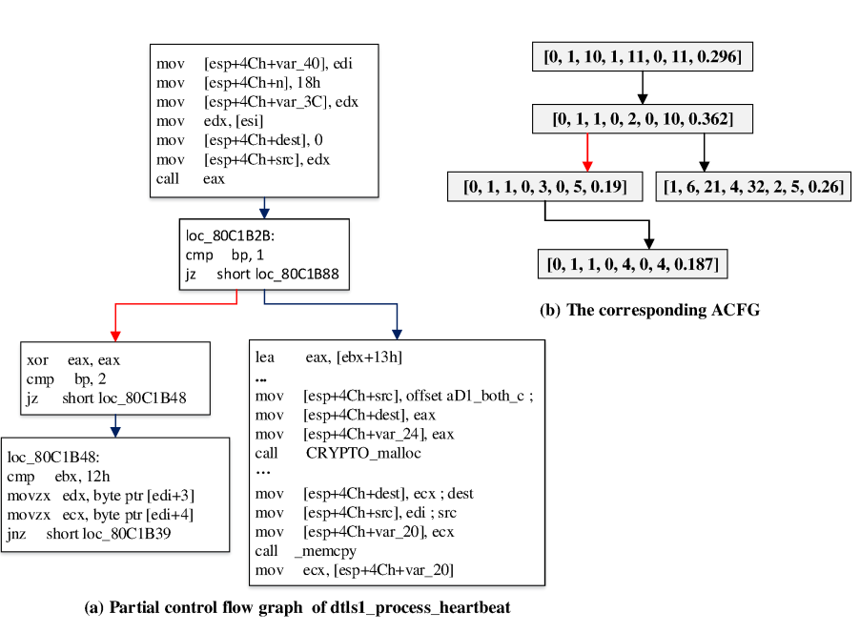
Artificially formulated features
Angr extract CFG of binary file
Each code block in CFG is extracted based on the manually defined atrribute and converted into an embedded vector.
Notes:
In general, pre-trained language models are learned on a lot of text data in a self-supervised manner, and then fine-turned on downstream tasks
It is very popular and can effectively improve the performance of many of natural language processing tasks.
In the past year , one of the important trends of pre-trained language models is their increasing model size ,which leads to lower perplexity in pre-training and better performances on downstream tasks
Although they are very successful, however, they are trained on plain text and do not introduce language knowledge, world knowledge etc. In addition, these large models are trained using autoregression, which does not perform well in solving downstream language understanding problems.

Slide 6
Machine learning-based features
Based on word2vec or self attention models.
Translate each instruction even character to vector
Notes:
In general, pre-trained language models are learned on a lot of text data in a self-supervised manner, and then fine-turned on downstream tasks
It is very popular and can effectively improve the performance of many of natural language processing tasks.
In the past year , one of the important trends of pre-trained language models is their increasing model size ,which leads to lower perplexity in pre-training and better performances on downstream tasks
Although they are very successful, however, they are trained on plain text and do not introduce language knowledge, world knowledge etc. In addition, these large models are trained using autoregression, which does not perform well in solving downstream language understanding problems.

Slide 7
Implementing multiple embedded vectors to influence each other
Based on Graph Neural Networks
Based on self attention Neural Networks
Notes:
In general, pre-trained language models are learned on a lot of text data in a self-supervised manner, and then fine-turned on downstream tasks
It is very popular and can effectively improve the performance of many of natural language processing tasks.
In the past year , one of the important trends of pre-trained language models is their increasing model size ,which leads to lower perplexity in pre-training and better performances on downstream tasks
Although they are very successful, however, they are trained on plain text and do not introduce language knowledge, world knowledge etc. In addition, these large models are trained using autoregression, which does not perform well in solving downstream language understanding problems.

Slide 8
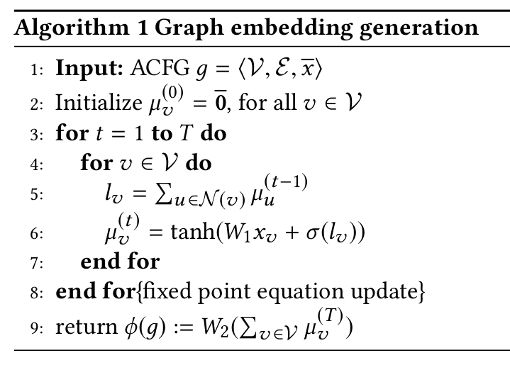
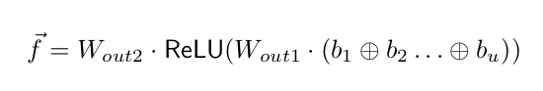
Generate a vector summarizing the overall function
Obtaining eigenvectors by simple matrix multiplication
Notes:
In general, pre-trained language models are learned on a lot of text data in a self-supervised manner, and then fine-turned on downstream tasks
It is very popular and can effectively improve the performance of many of natural language processing tasks.
In the past year , one of the important trends of pre-trained language models is their increasing model size ,which leads to lower perplexity in pre-training and better performances on downstream tasks
Although they are very successful, however, they are trained on plain text and do not introduce language knowledge, world knowledge etc. In addition, these large models are trained using autoregression, which does not perform well in solving downstream language understanding problems.

Slide 9
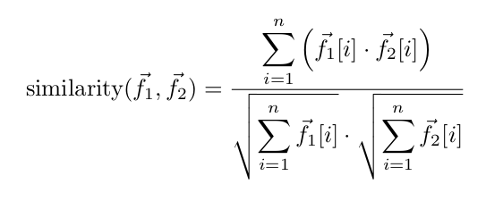
Similarity function between functions
cosine similarity is most wildly used
Notes:
In general, pre-trained language models are learned on a lot of text data in a self-supervised manner, and then fine-turned on downstream tasks
It is very popular and can effectively improve the performance of many of natural language processing tasks.
In the past year , one of the important trends of pre-trained language models is their increasing model size ,which leads to lower perplexity in pre-training and better performances on downstream tasks
Although they are very successful, however, they are trained on plain text and do not introduce language knowledge, world knowledge etc. In addition, these large models are trained using autoregression, which does not perform well in solving downstream language understanding problems.

Slide 10
02
Specific experimental route (draft)

Slide 11
Binary source selection
binutils, ccv, coreutils, curl, gsl, libhttpd, openmpi, openssl
（Based on the database commonly used in the paper)
Notes:
In general, pre-trained language models are learned on a lot of text data in a self-supervised manner, and then fine-turned on downstream tasks
It is very popular and can effectively improve the performance of many of natural language processing tasks.
In the past year , one of the important trends of pre-trained language models is their increasing model size ,which leads to lower perplexity in pre-training and better performances on downstream tasks
Although they are very successful, however, they are trained on plain text and do not introduce language knowledge, world knowledge etc. In addition, these large models are trained using autoregression, which does not perform well in solving downstream language understanding problems.

Slide 12
CFG extraction
Based on argn extra each CFG (with code block) of all the binary files.
Notes:
In general, pre-trained language models are learned on a lot of text data in a self-supervised manner, and then fine-turned on downstream tasks
It is very popular and can effectively improve the performance of many of natural language processing tasks.
In the past year , one of the important trends of pre-trained language models is their increasing model size ,which leads to lower perplexity in pre-training and better performances on downstream tasks
Although they are very successful, however, they are trained on plain text and do not introduce language knowledge, world knowledge etc. In addition, these large models are trained using autoregression, which does not perform well in solving downstream language understanding problems.

Slide 13
Based on instruction2vec extra feature
The vector corresponding to each instruction is calculated based on i2v and the binary code library
The vector of each code block is obtained through the self-attention model
Get total vector of the function based on GNN
Notes:
In general, pre-trained language models are learned on a lot of text data in a self-supervised manner, and then fine-turned on downstream tasks
It is very popular and can effectively improve the performance of many of natural language processing tasks.
In the past year , one of the important trends of pre-trained language models is their increasing model size ,which leads to lower perplexity in pre-training and better performances on downstream tasks
Although they are very successful, however, they are trained on plain text and do not introduce language knowledge, world knowledge etc. In addition, these large models are trained using autoregression, which does not perform well in solving downstream language understanding problems.

Slide 14
Based on instruction2vec extra feature
The vector corresponding to each instruction is calculated based on i2v and the binary code library
The vector of each code block is obtained through the self-attention model
Get total vector of the function based on GNN
Notes:
In general, pre-trained language models are learned on a lot of text data in a self-supervised manner, and then fine-turned on downstream tasks
It is very popular and can effectively improve the performance of many of natural language processing tasks.
In the past year , one of the important trends of pre-trained language models is their increasing model size ,which leads to lower perplexity in pre-training and better performances on downstream tasks
Although they are very successful, however, they are trained on plain text and do not introduce language knowledge, world knowledge etc. In addition, these large models are trained using autoregression, which does not perform well in solving downstream language understanding problems.

Slide 15
3. Graph Embedding
The vector corresponding to each instruction is calculated based on i2v and the binary code library
The vector of each code block is obtained through the self-attention model
Get total vector of the function based on GNN
Notes:
In general, pre-trained language models are learned on a lot of text data in a self-supervised manner, and then fine-turned on downstream tasks
It is very popular and can effectively improve the performance of many of natural language processing tasks.
In the past year , one of the important trends of pre-trained language models is their increasing model size ,which leads to lower perplexity in pre-training and better performances on downstream tasks
Although they are very successful, however, they are trained on plain text and do not introduce language knowledge, world knowledge etc. In addition, these large models are trained using autoregression, which does not perform well in solving downstream language understanding problems.

